Slide 1
The Object Class
AP Computer Science A

Slide 2
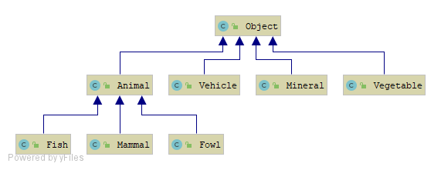
The Object Class
The Object (java.lang.Object) class is the universal super class, meaning all classes have an is-a relationship with Object.

Slide 3
Some Object Class Methods
public String toString(): Converts the object to a String. Overriding this allows a meaningful String representation of the class to be defined. By default, it returns: nameOfClass@someNumber
public boolean equals(Object obj): Returns true if this and obj are pointing to the same object. Override this to check equality based on state, not on memory.
public int hashCode(): Maps the object to an integer. If two objects are equal, their hash codes should be equal. However, if two objects have the same hash code, they are not necessarily equal. An object’s hash code is used for indexing in a hash table. This method and hash tables are not a part of the AP exam.

Slide 4
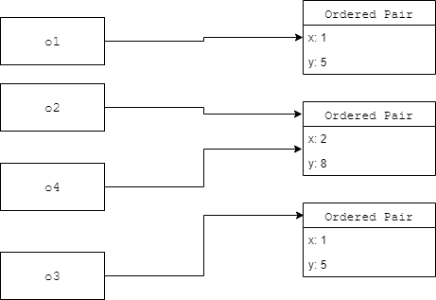
Object Equality

Slide 5

Any Questions?

